Slide 1
NeRFInvertor: High Fidelity NeRF-GAN Inversion for Single-shot Real Image Animation
Presented By: Jingjie Qian, Malia Howe, Rongxuan Zhou

Slide 2
Contents
01. Motivations
02. Data Used
03. Key Insights
04. Visualizations
05. What We Learned
06. Questions

Slide 3
Motivations
01

Slide 4
Image Animation
Novel Views and Expressions
Create an inversion method that could generate an image with novel views and expressions from a static image
3-D Geometrical Consistency
Identity Preservation
NeRFInvertor Method

Slide 5
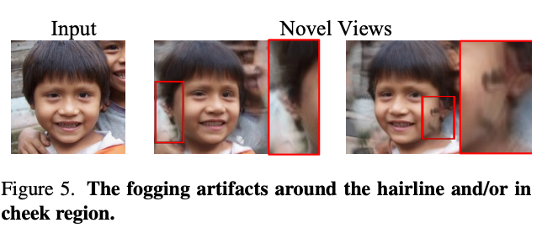
Artifacts

Slide 6
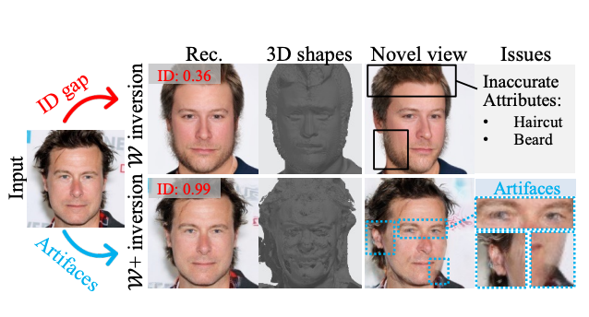
Identity Gap

Slide 7
Data Used
02

Slide 8
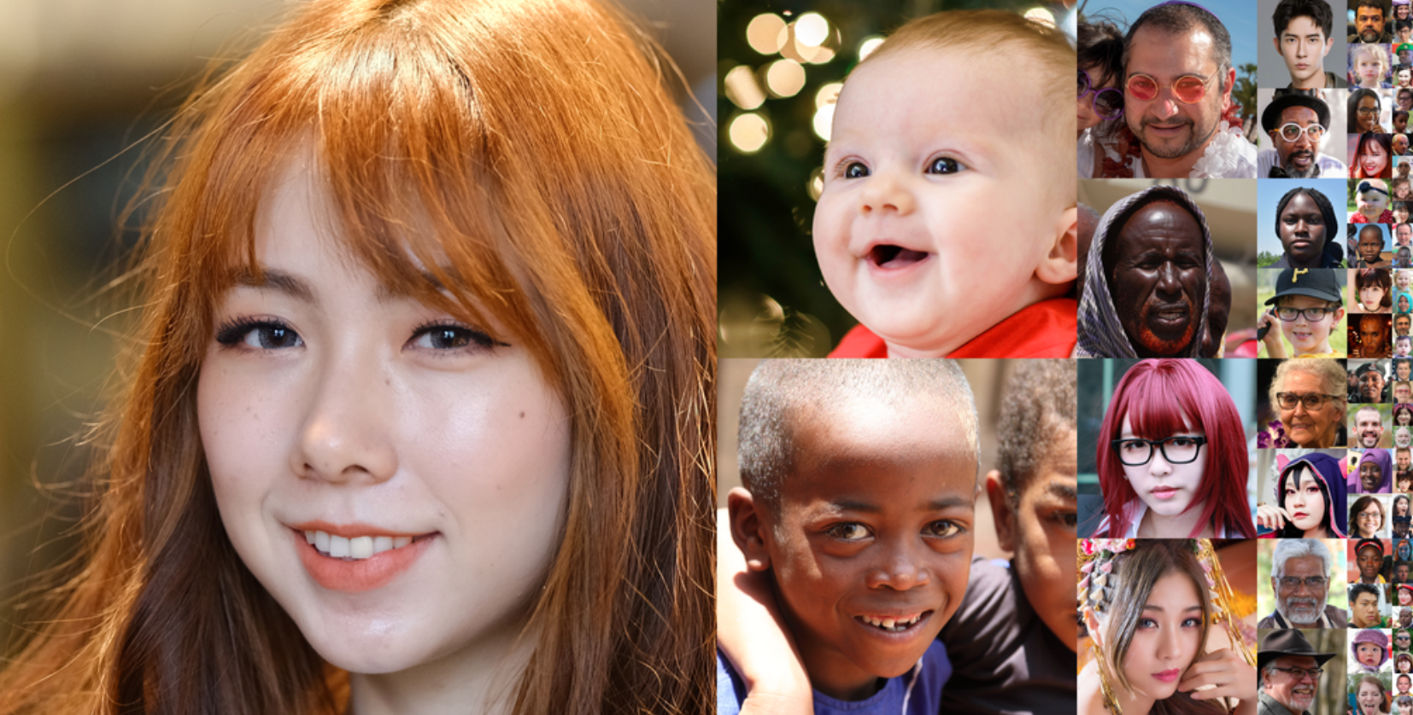
Data Used
Images of Real People (Celebrities)
CelebA-HQ
FFHQ
Models
AniFaceGAN
GRAM
Methods
I2S (W)
I2S (W+)
PTI

Slide 9
Key Insights
03

Slide 10
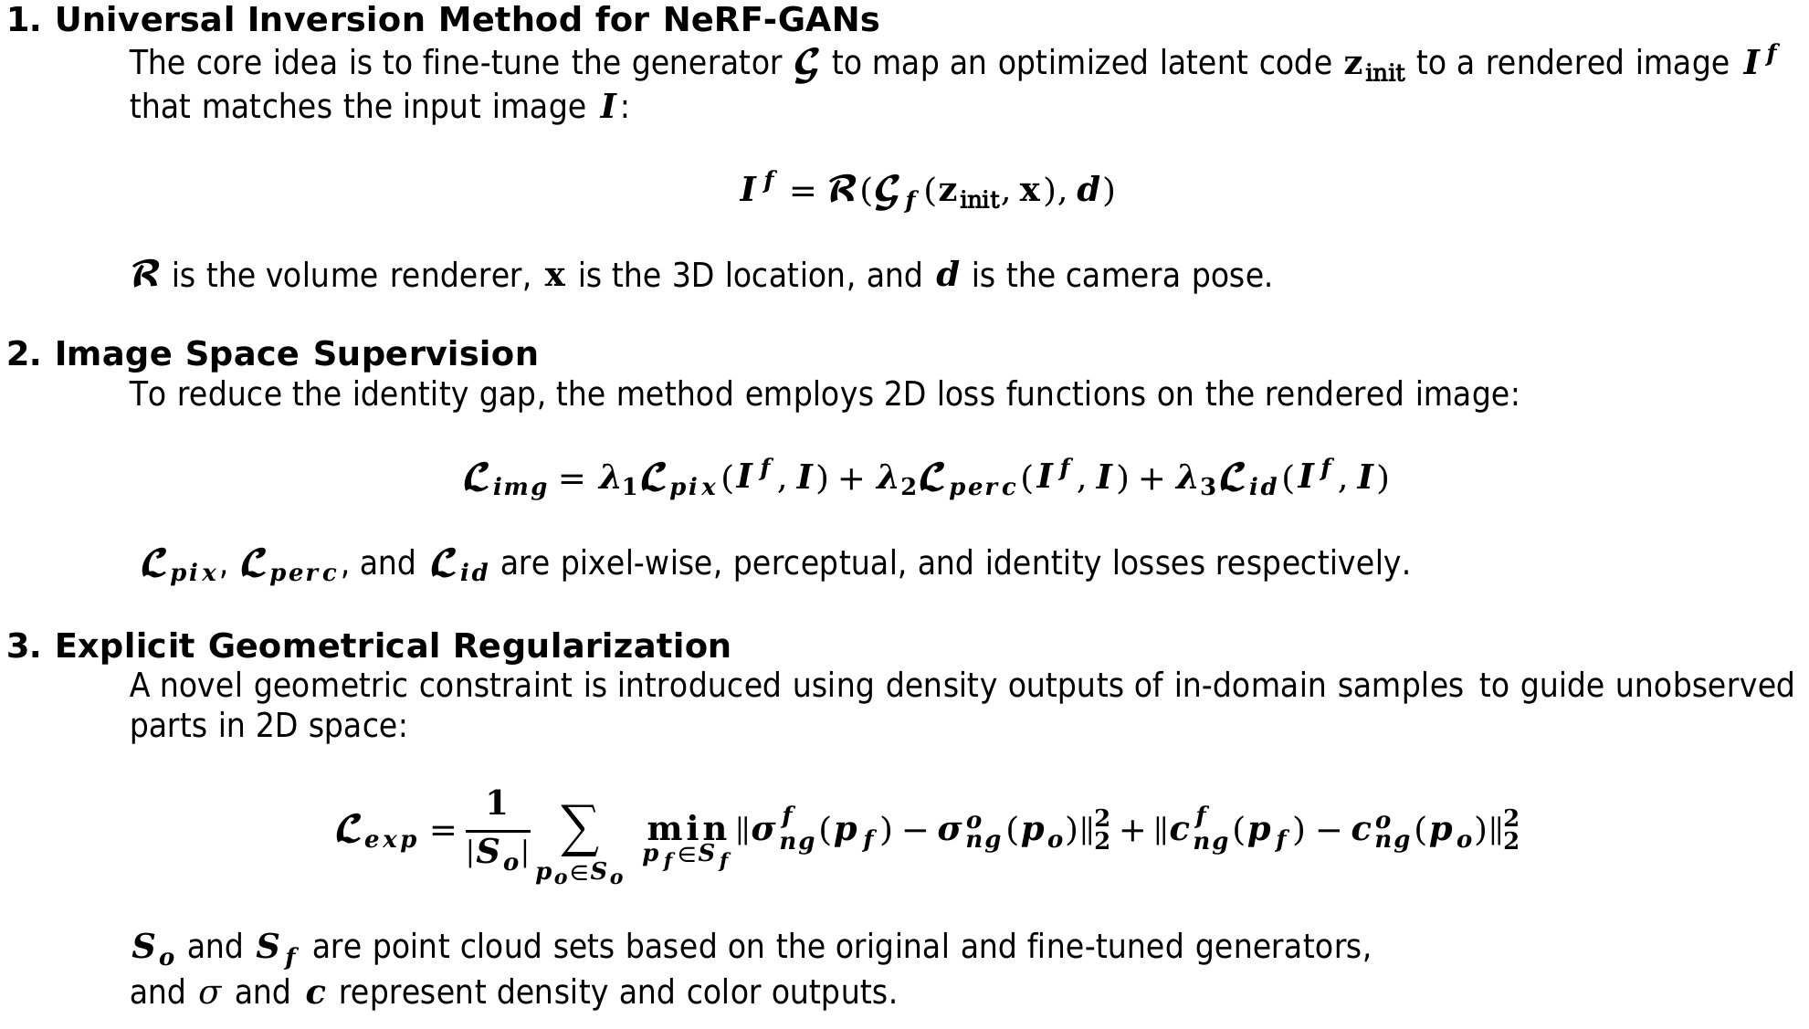

Slide 11
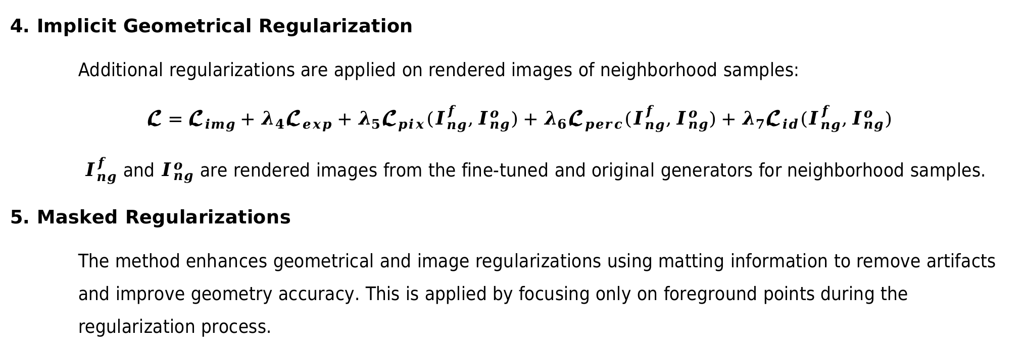
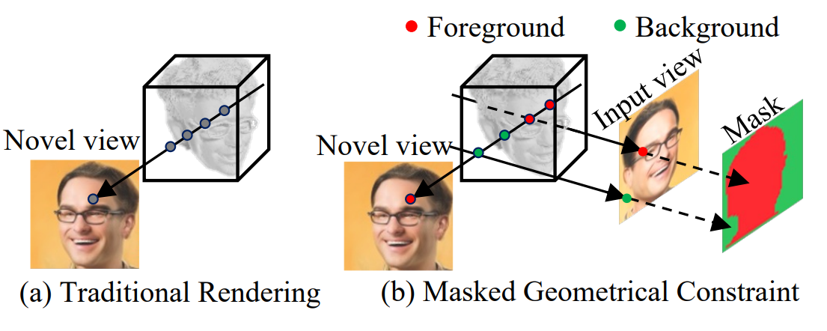

Slide 12
Visualizations
04

Slide 13
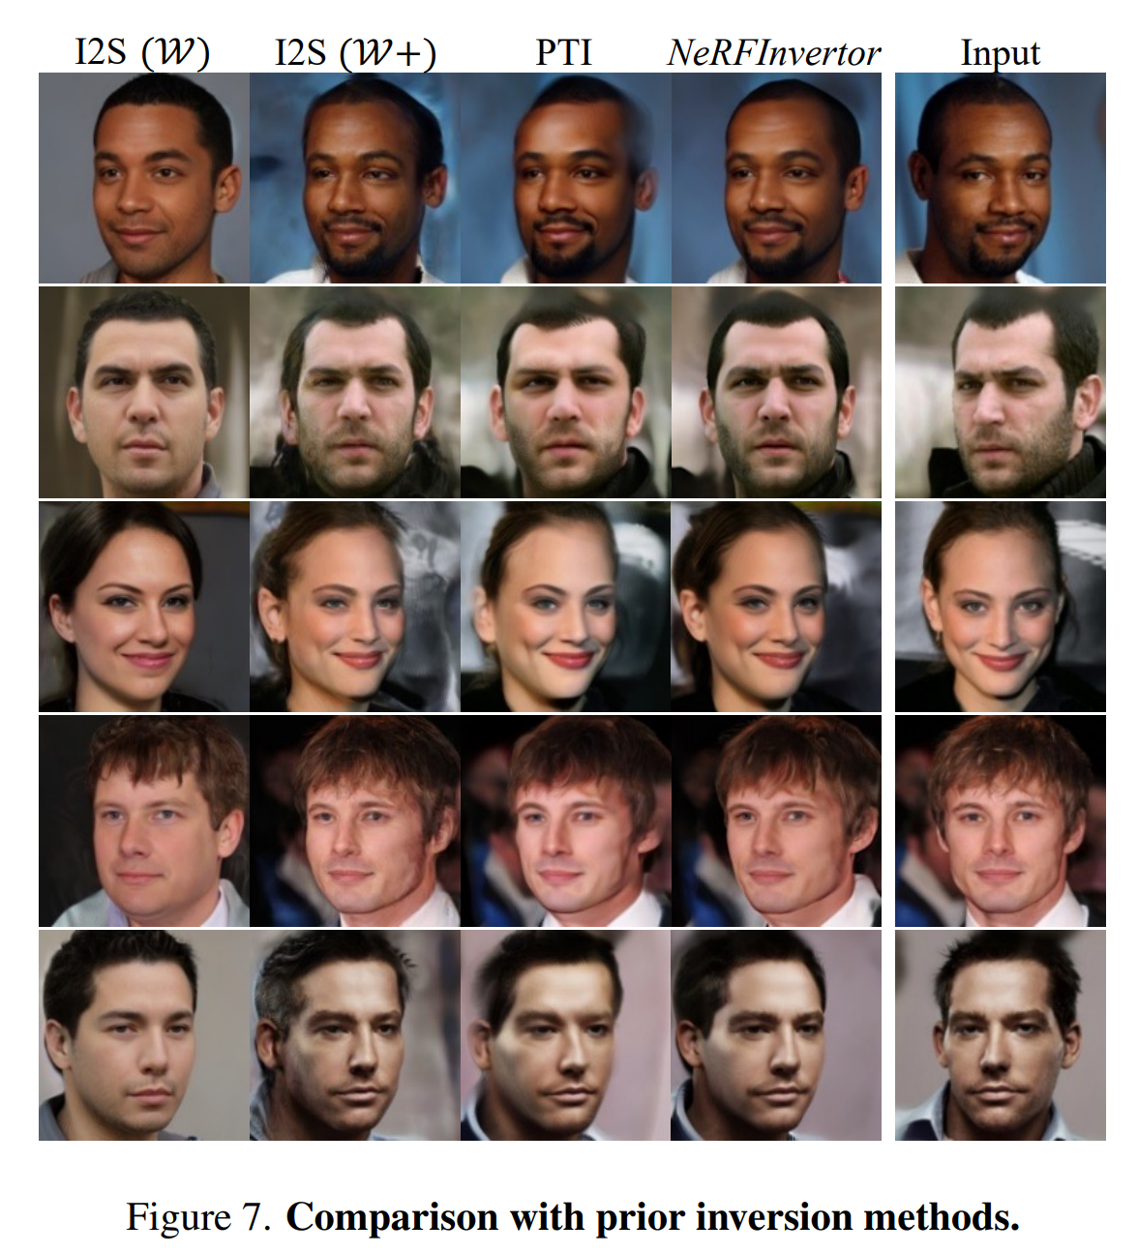
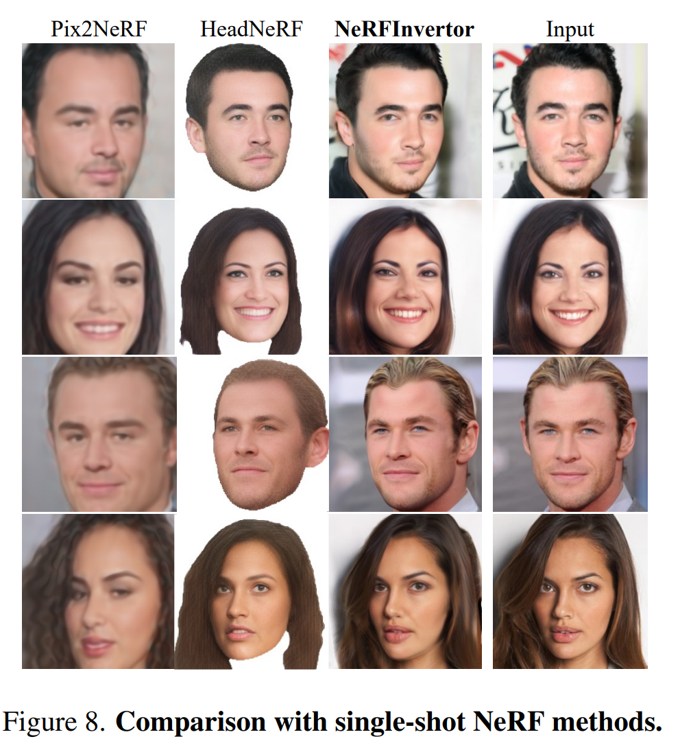
1. Comparison Figures

Slide 14
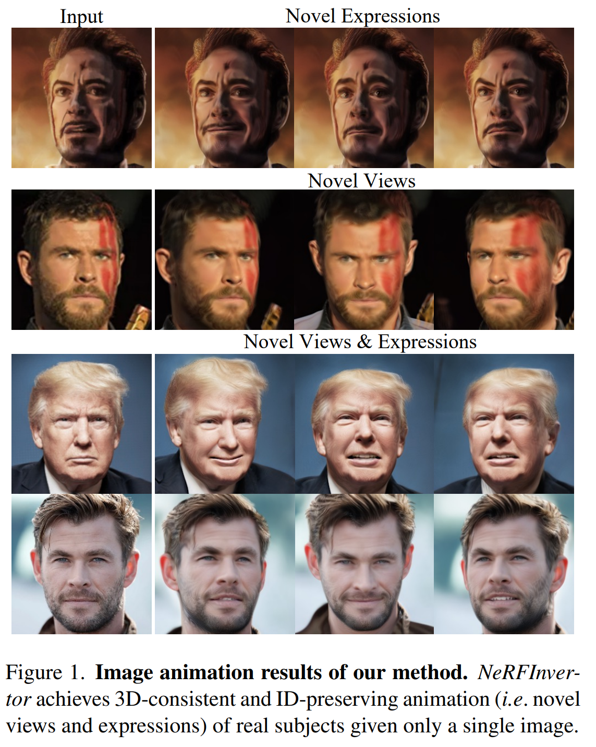
2. Animation Results

Slide 15
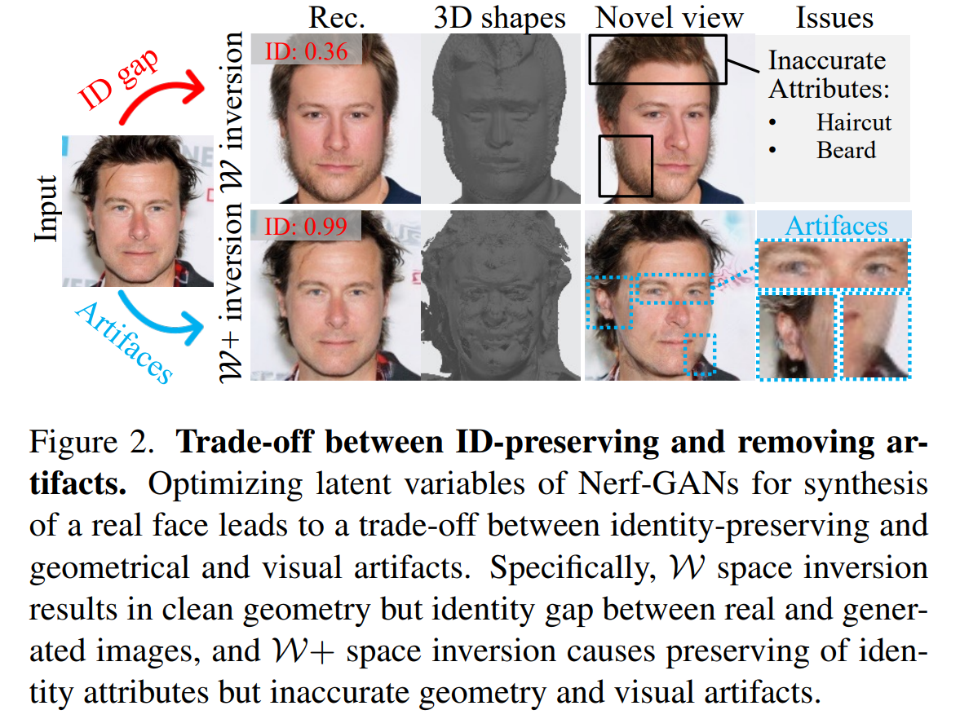
3. Trade-off Visualization

Slide 16
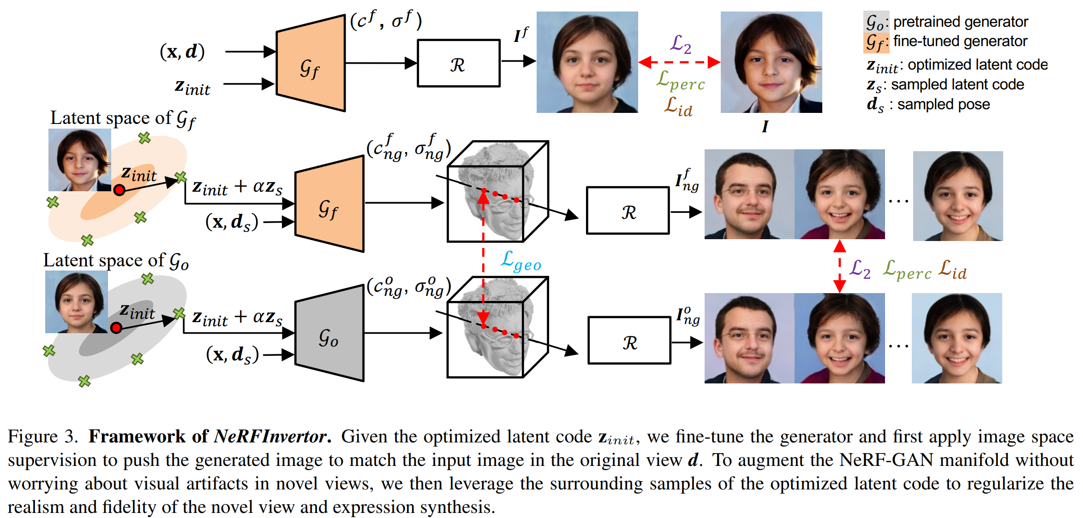
4. Framework Diagram

Slide 17
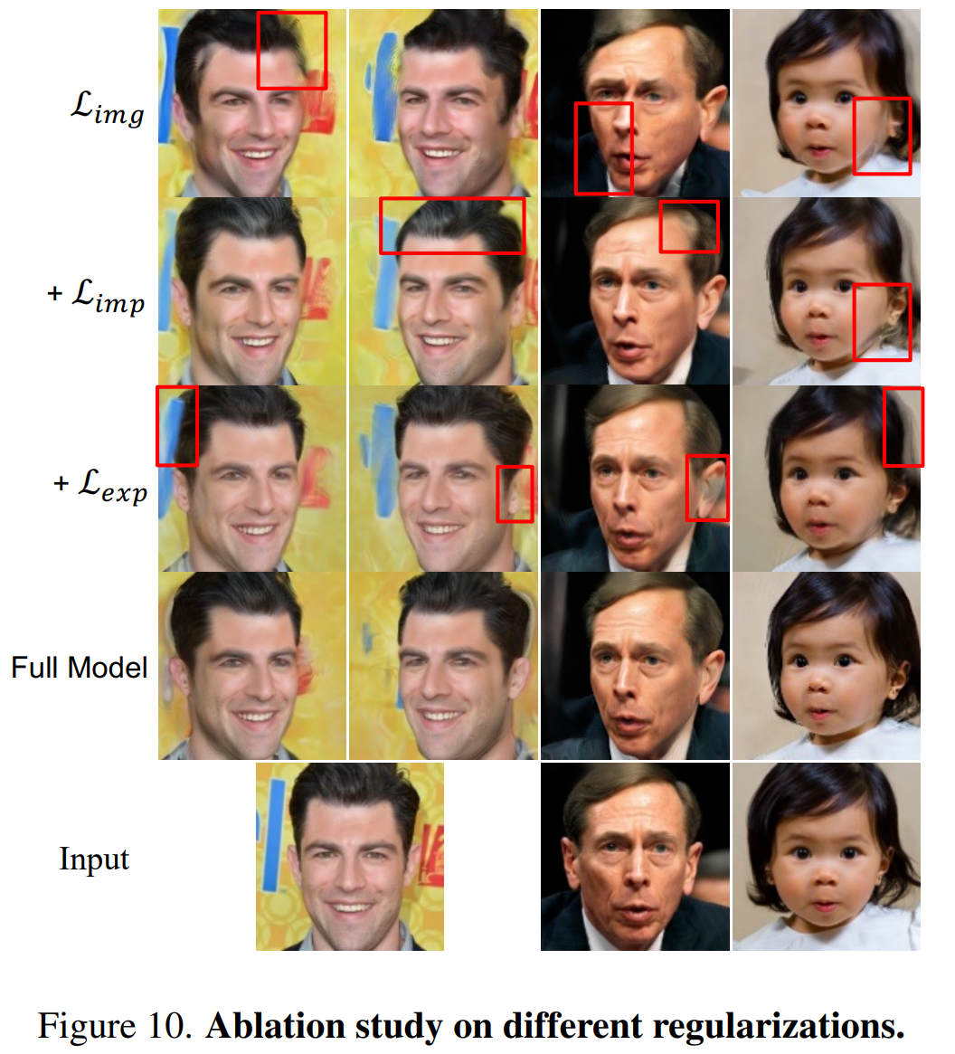
5. Ablation Studies

Slide 18
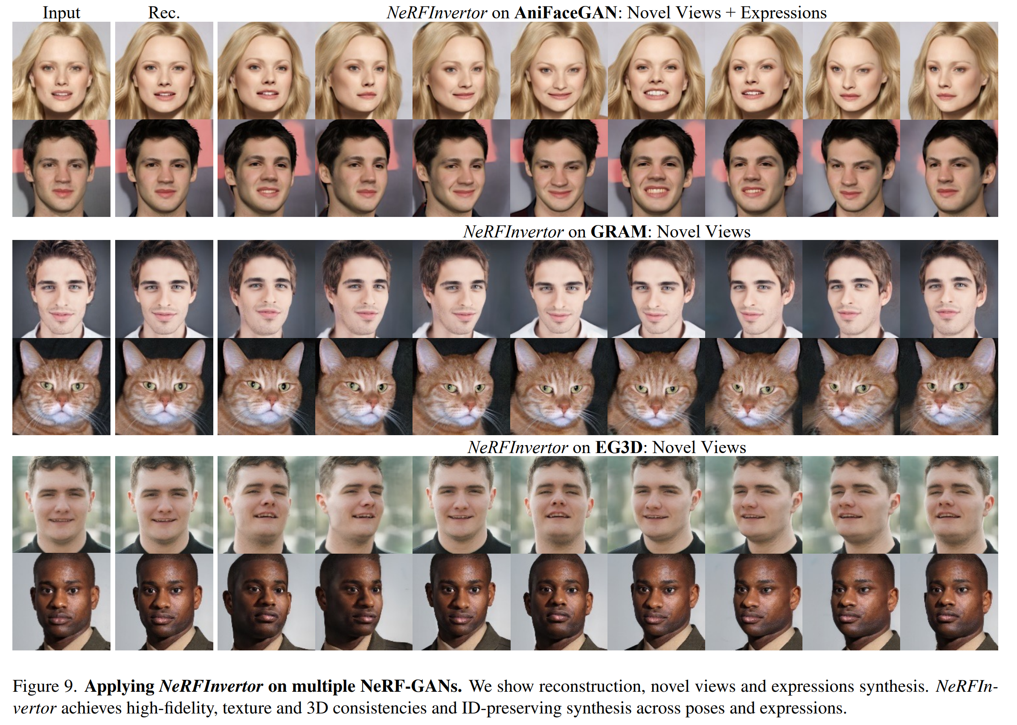
6. Multi-model Results

Slide 19
What We Learned
05

Slide 20
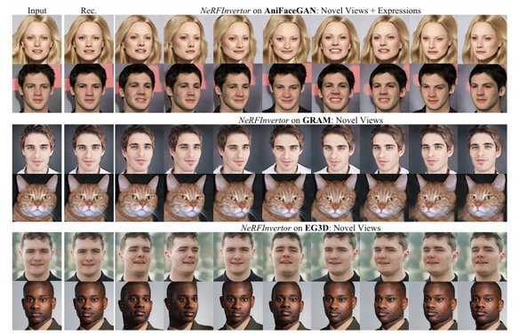
Single-Image to 3D Visualization Workflow
The visual strategy of starting with a single 2D portrait and demonstrating its transformation into a 3D representation.
Authors illustrate how a single 2D input can be mapped to density and color fields (the NeRF representation).
This approach underscores the importance of multi-step visual pipelines—showing how raw data (the single photo) is progressively interpreted (by the NeRF-GAN) into a volumetric format and then rendered from novel viewpoints.
Cr.introduction,3.1 Image Space Supervision,4.2 Qualitative Evalution​

Slide 21
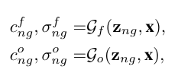
Comparison of Color and Density Fields
​
Cr.3.2 Explicit Geometrical Regularization​ 3.3 Implicit Geometrical Regularization
The paper highlights density outputs and color distributions in 3D space rather than only showing final rendered images.
By offering both a visual (2D projections) and a structural (3D density) perspective, the authors help readers pinpoint where errors or artifacts might originate—whether it’s an issue with geometry, shading, or identity resemblance.

Slide 22
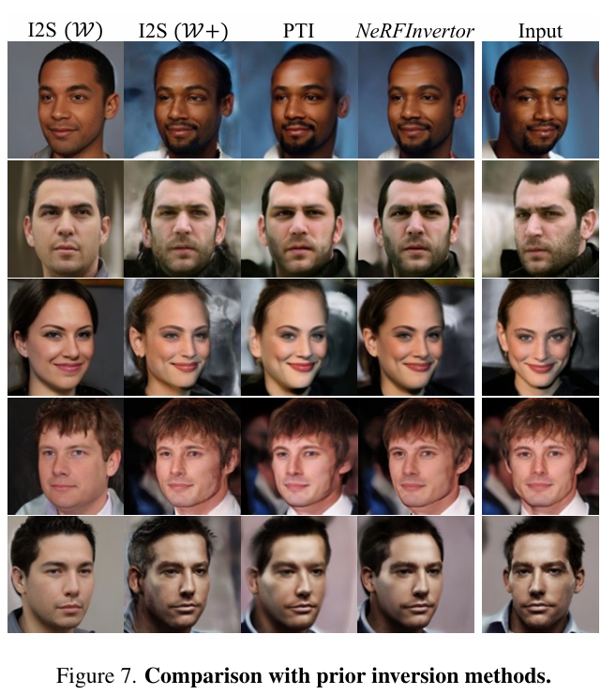
Side-by-Side Novel View Comparisons
The authors routinely present multi-view snapshots—for instance, rotating the camera around the face. They line up the results for different baselines to compare identity preservation and artifact formation in real-time across angles.
This style of grid-based or row-by-row display makes it easy to see how each method deals with pose changes, ensuring the reader can visually confirm which approach maintains identity and geometry most faithfully.

Slide 23
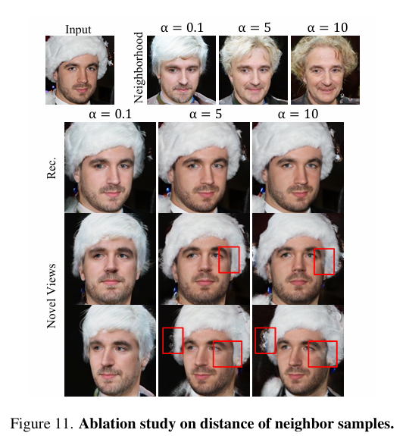
Foreground Masking & Ablation Visuals
Foreground–background mask is another innovative visualization element. The paper does not simply apply the mask behind the scenes; it shows how applying a mask reduces “fogging” or “blurriness” around hairlines or cheeks.
This helps illustrate the direct impact of each design choice (explicit vs. implicit constraints, masked vs. unmasked) on the final image.
By providing side-by-side ablation, readers see exactly how each component enhances or degrades the final render.

Slide 24

Neighborhood Sampling Visualization
Sampling latent codes around Z_{init} to regularize geometry—is also illustrated by showing how the original generator vs. the finetuned generator behave for those neighbor codes.
By visualizing these “neighbor” outcomes, readers understand how the method enforces consistency in unobserved or partially observed regions.
Example of how to visualize not just the final phenomenon (a single test image) but also the latent-space manipulation that underpins the method’s success.

Slide 25
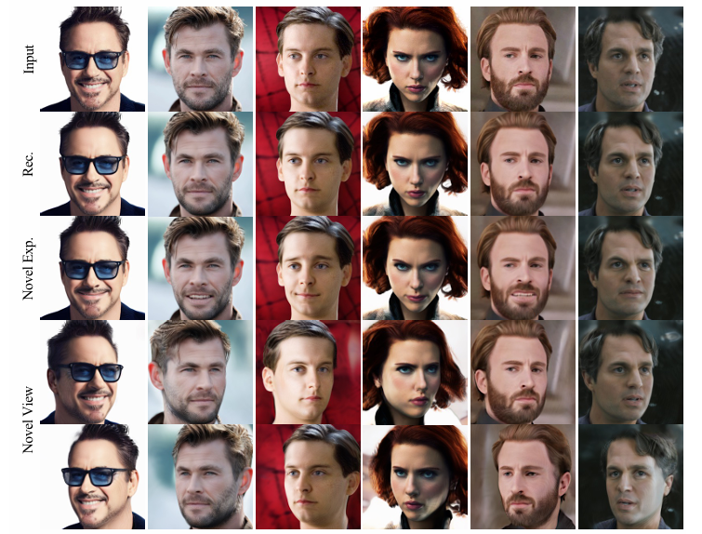
Insights on Data Handling for Experiments
Real image animation example on the “Avengers”
Pretrained NeRF-GANs (trained on large-scale datasets, like FFHQ or CelebA-HQ) provide strong priors for geometry and appearance. The authors emphasize that one can rely on these priors to fill in missing details for unseen viewpoints.
Their experiment design consistently tests both in-distribution samples (images close to the training set style) and out-of-distribution samples (e.g., celebrities, photos under unusual conditions) to see how well their visualization and geometry hold up. This reveals the robustness in a clearly laid-out comparative format.

Slide 26
Questions
06

Slide 27
Why might purely image-level losses on a single photo lead to geometry artifacts under novel viewpoints?
How do “explicit” vs. “implicit” geometric constraints each help preserve 3D consistency?
Why sample latent codes near z_{init} instead of using random distant codes?
Can we apply this single-image inversion method to objects beyond faces, such as full bodies or arbitrary scenes?
What are the biggest limitations or future directions for this approach (e.g., data requirements, model complexity)?
Do you think that there are ethical implications that need to be taken into consideration with the improvement of NeRF-GAN methods?

